Slide 1

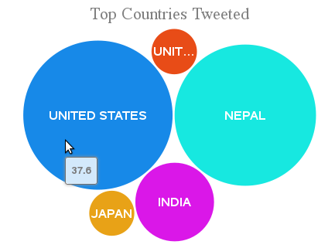
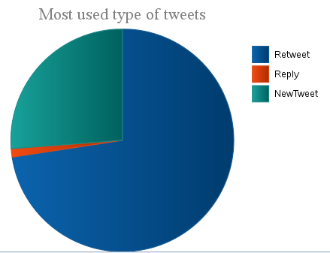
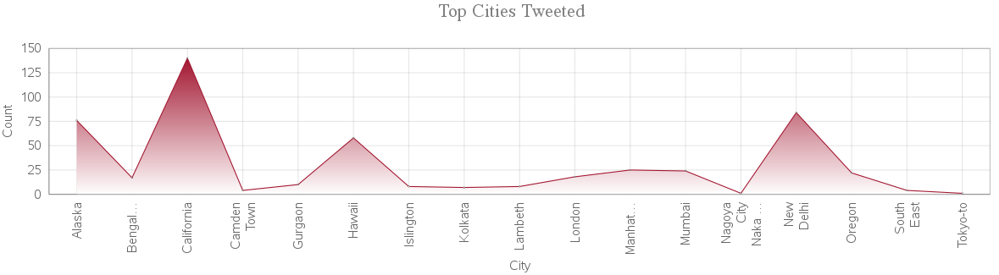
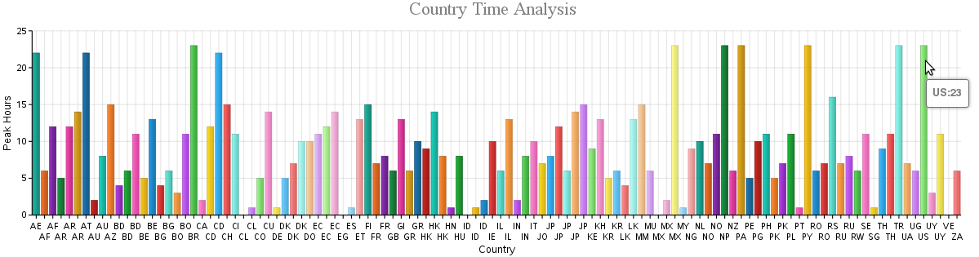
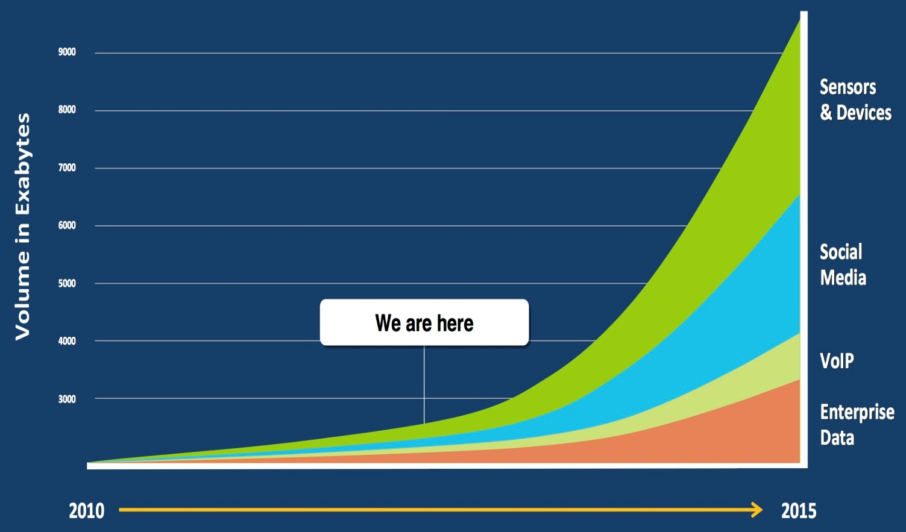
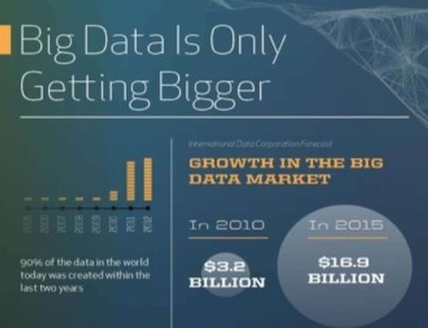
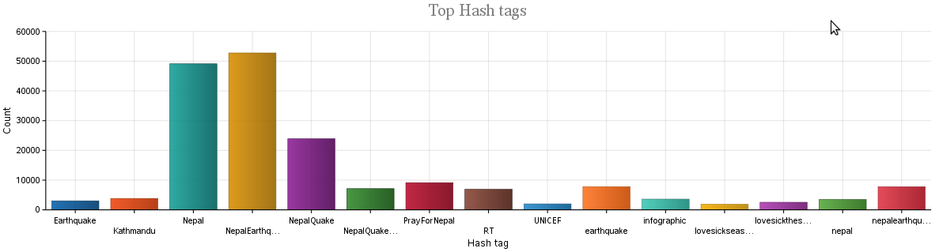
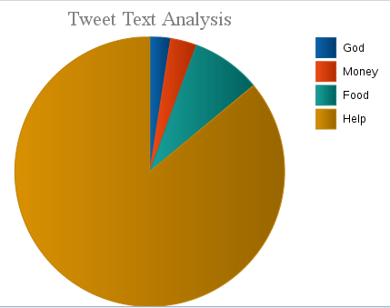

Contextual and Text Analysis of Nepal Tweets
Keerthi Yanda, Sandeep Ballu, Rakesh Vistarakula | Praveen Rao, Anas Katib | School of Computing And Engineering, University of Missouri – Kansas City
Objective
Key Challenges
Results
Using the various tools in Hadoop framework, implement ETL process and visualize the extracted data in graphical format
Structured to unstructured data
Data collected from twitter is in JSON, which cannot be directly loaded into database for feasible analysis
Data extraction
Extracting the data from the Hive warehouse using the complex joins was time taking and challenging task
Visualization and deployment
Visualizing the analyzed data was challenging task. IBM Bigsheets made it easier
Deploying the entire project on cloud was challenging
Motivation
Usage of the unstructured data and implementing the big data tools to analyze the visualize the large amounts of structured and unstructured data is popularly in demand
Social media data could be used to extract information
Tools and Technologies
Tool | Purpose
Eclipse | Java programming
Twitter API | Twitter authorization
IBM Big Insights | Hadoop Framework
IBM Big Insights | Hive
IBM Big Sheets | Data visualization
JSP | User Interface
Data / Observations
1 GB of data is collected and analyzed
Contextual analysis includes
Top 5 tweeted countries are United States, Nepal, India, UK and Japan. USA tweeted the most
Top cities tweeted are extracted. California being the top city
Most Active time of the users is extracted city based on city
Type of tweet is extracted, which included – retweet, reply, new tweet
Text analysis includes:
Based on text, tweets are categorized into 4 types – god, money, food, help
Top Hashtags used for Nepal tweets #NepalEarthquake and #Nepal being the most used
Project Overview
Twitter is one of the social media. We collected tweets related to recent Nepal Earthquake using twitter API and used hive warehouse for ETL processing and IBM Big sheets for data visualization
Conclusion
contextual and text analysis of Tweets is done and visualized
Works Cited
https://apps.twitter.com/app/7883650/show
http://www-01.ibm.com/software/data/infosphere/hadoop/enterprise.html https://hadoop.apache.org/
https://hive.apache.org/

